Slide 1



​COLLABORATIVE WRITING FOR CHILDREN’S MULTILITERACY SKILLS UTILISING MULTIMODAL TOOLS
(DIGITAL) STORYTELLING IN EDUCATION
- August 2020 -

Slide 2

StoryLogicNet Community – Collaborative Writing for Children’s Multiliteracy Skills Utilising Multimodal Tools
PROJ. Nº 2018-1-PT01-KA201-047325​
Title: (DIGITAL) STORYTELLING IN EDUCATION
Project Activity:
Date: August 2020
Version: 1.0
Developed by: UOWM
Contributions: Advancis Business Services, Lda (Portugal), ISJA, SP1, Schole
The European Commission support for the production of this publication does not constitute an endorsement of the contents which reflects the views only of the authors, and the Commission cannot be held responsible for any use which may be made of the information contained therein.

Slide 3
CONTENT
Storytelling definition
Structuring a story
Storytelling in Education
Examples

Slide 4
STORYTELLING

Slide 5
Storytelling: the art of utilizing voice/sound, language, movement, gestures and facial expressions in order to provoke thoughts, emotions and images in the brain of the “audience”
Story: has specific structure, can be categorized in types of stories and has widely accepted structural elements
Telling: involves a connection between teller-audience and the time-space where the story “lives”. The Teller prepares and presents the story elements utilizing resources in order to create “magic”. At the same time he/she listens to (using also his/her eyes) the reactions of the audience and reacts appropriately so as to maintain their interest

Slide 6
STORYTELLING
Definition
It is an act of communication through which a series of real or fictional elements is presented (orally or written)
Dynamic relationship between story, teller and audience. It is a collaborative, creative activity in which the audience is not a passive recipient, but is alive, in vigilance
Teller
Recipient

Slide 7
SINCE WHEN?
Egypt (4000 BC)
Giglamesh (1800BC)
Kelts
Homer-Aristotle
Nibelungenlied
1001 Nightw (India, Iran, Syria)
Bards – Troubadours
…

Slide 8
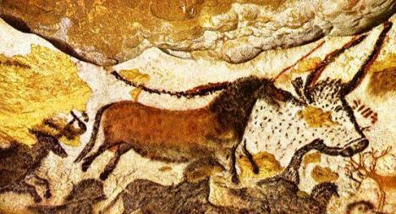
EVEN OLDER
Lascaux – 40,000BC

Slide 9
DISCRETE NARRATIVE PARTS
Narrative content: facts and actions
Narrative act: the way that the narrator presents the facts and actions
CAUTION: they can be very different, depending on the narrator

Slide 10
Elements of a good story
Point of view
Dramatic question
Voice
Contrast: Text & image
Rhythm, tone and tempo
Narrative structure
Audience
Immersion, connection and engagement
Backstory

Slide 12
What does an expert say?
The thing is the power of stories and storytelling.
It can take you….be lost in a story
You can get really lost in a story
It’s the power of these damn things
They get inside you, they can take you over
You can take people over with a story
You can get them where you want them to, you can get them anywhere…
…whether they like it or not
Ben Haggerty Performance Storyteller
https://www.youtube.com/watch?v=gtnrB75MKlY

Slide 13
What matters
Story without digital works, digital without story doesn’t (Ohler, 2008)
Intense emotional reaction
Personal identification elements

Slide 14
Digital Storytelling
Definition;
There is no clear definition that is widely accepted.
It is the practice which combines narration with digital content/material such as images, sounds and video in order to create a short movie, often with an intense emotional constituent (Educause, 2009)
But it can be in other formats too…

Slide 15
Digital storytelling in Education
European Internet Foundation: the key to adequately prepare learners for life in a digital world is to “redesign education itself around participative, digitally-enabled collaboration within and beyond the individual educational institution”.
Vygotsky: knowledge construction derives from one’s explanation of the world to oneself and to the others. Stories are used to make meaning from experiences and to convey meaningful information to others.

Slide 16
(Digital) storytelling in the classroom and not only
(Digital) stories:
  Created by the teacher
  Created by the students
  Utilization of known/ready stories

Slide 17
Created/utilized by the teacher
Teaching tool:
Presenting a complex concept in a simpler way
Enhancing students' interest & interaction with content
Introduction to an activity or a sub-phase
When?
At the beginning of an activity or session
How?
Almost always with accompanying activities

Slide 18
Created by the students
Learning tool – acquisition test - application:
Literacy enhancement
Cultivation of skills (21st century)
Assessment – acquisition test
Application of knowledge
When?
Usually at the end
How?
Freely or with step-by-step guidance
Various materials and tools

Slide 19
So…
Why stories?

Slide 20
People can tell stories about things they cannot explain in an abstract way
More knowledge and experiences are conveyed through stories than through the abstract transmission of information
Stories bridge the gap between knowledge and action (understanding complex data)
The listener not only listens, but experiences
Education:
  Stories are easier to understand, remember and transferable than simple explanations-lectures
  50 MB of data is not knowledge, as 50,000 tons of concrete is not a skyscraper (Stoll, 1996)

Slide 21
SOME EXAMPLES

Slide 22
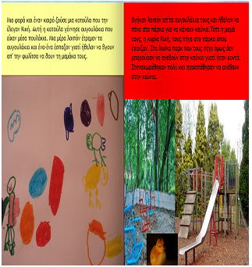
Children as writers express themselves and cultivate skills and literacies

Slide 23
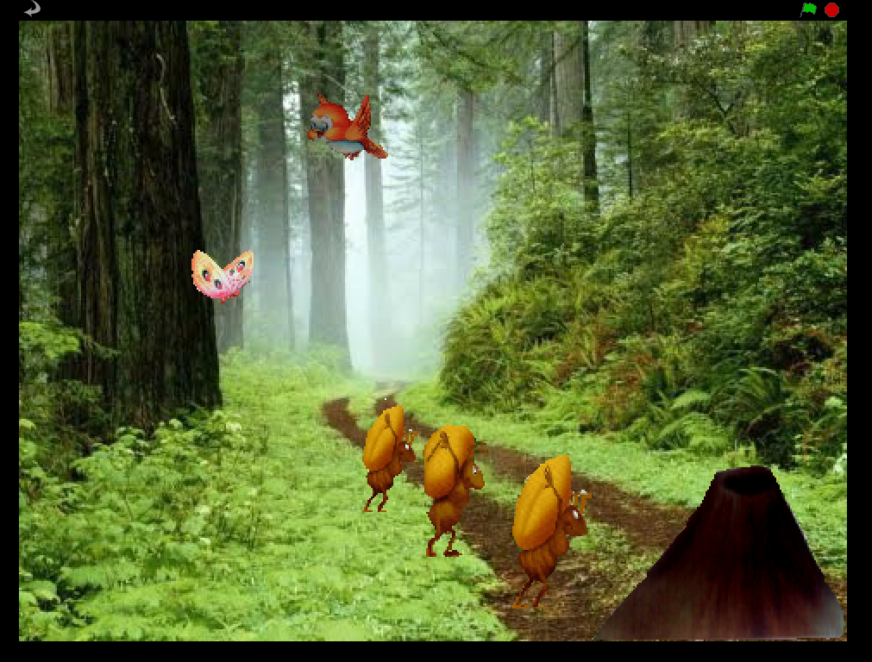
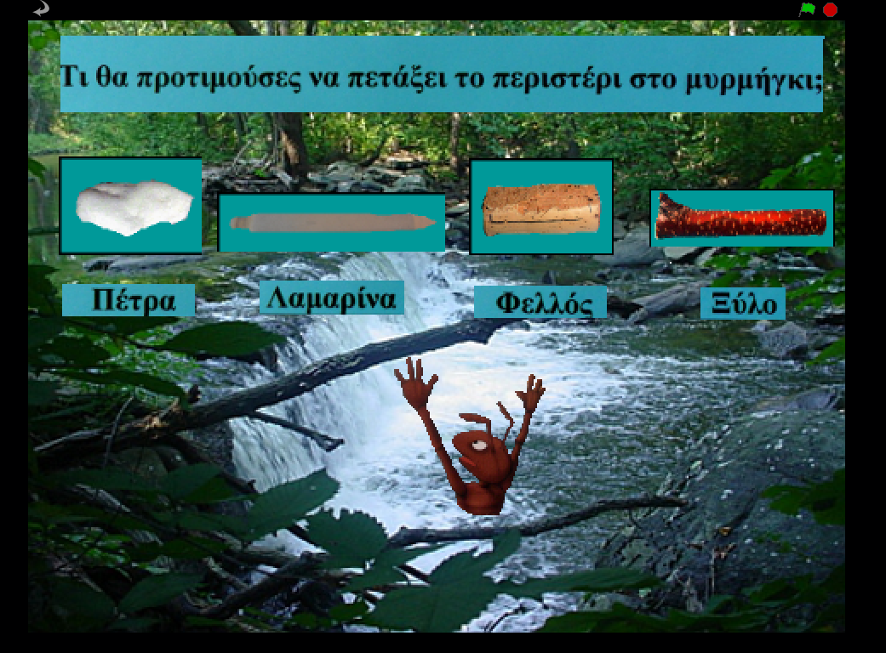
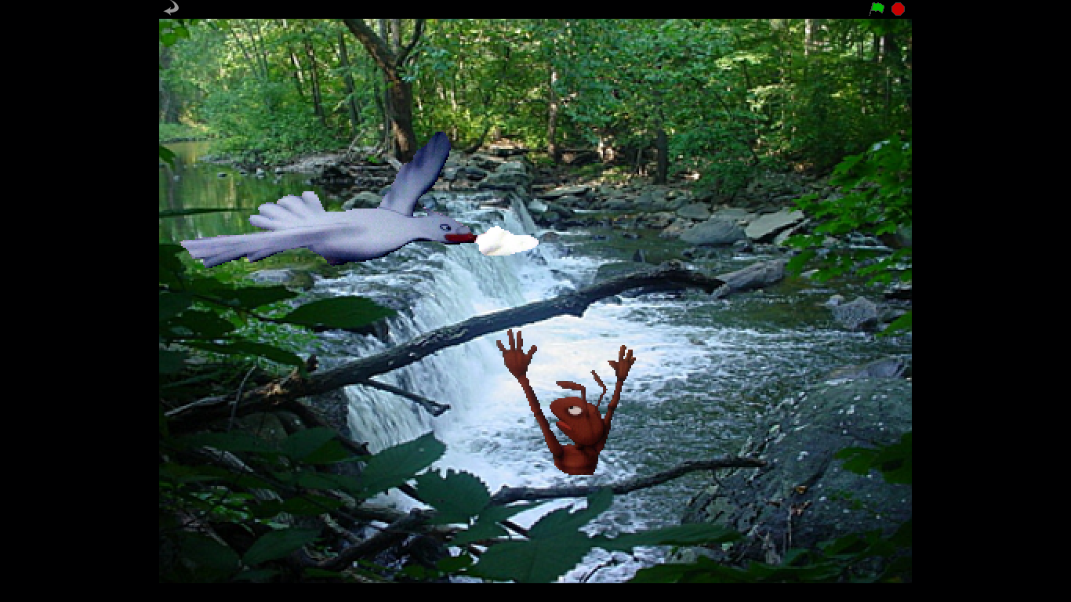
Aesop’s myth modified for teaching sciences

Slide 24

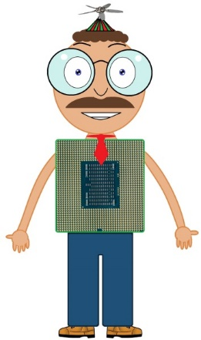
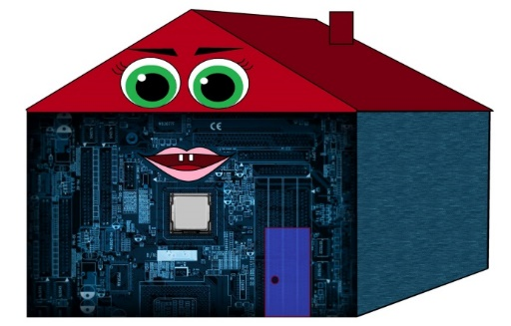
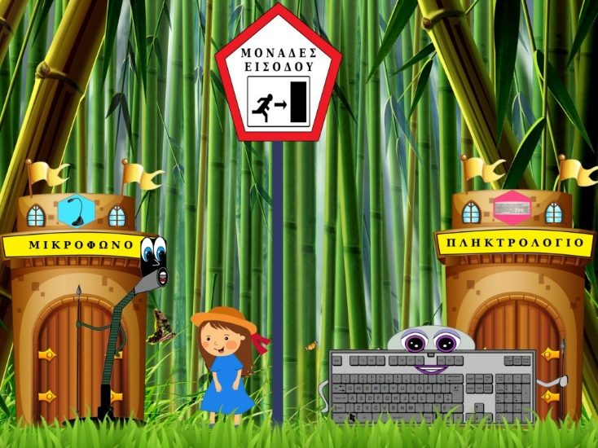


Computer Science – Elements of a computer and information flow

Slide 25
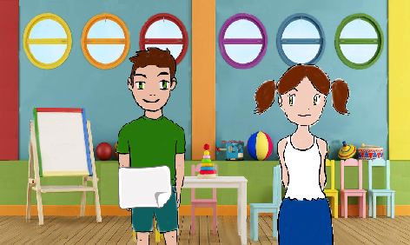
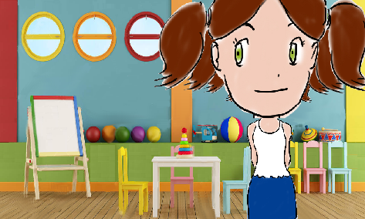
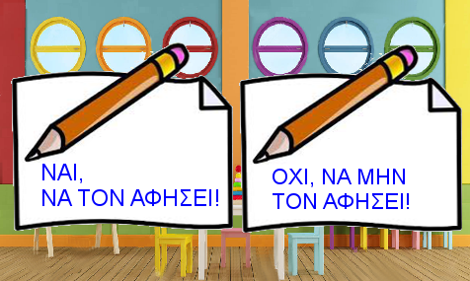
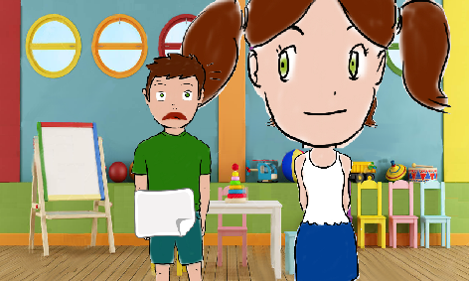
Complex social issues – interacting with Autism

Slide 26
Mathematics (the subtraction algorithm)

Slide 27
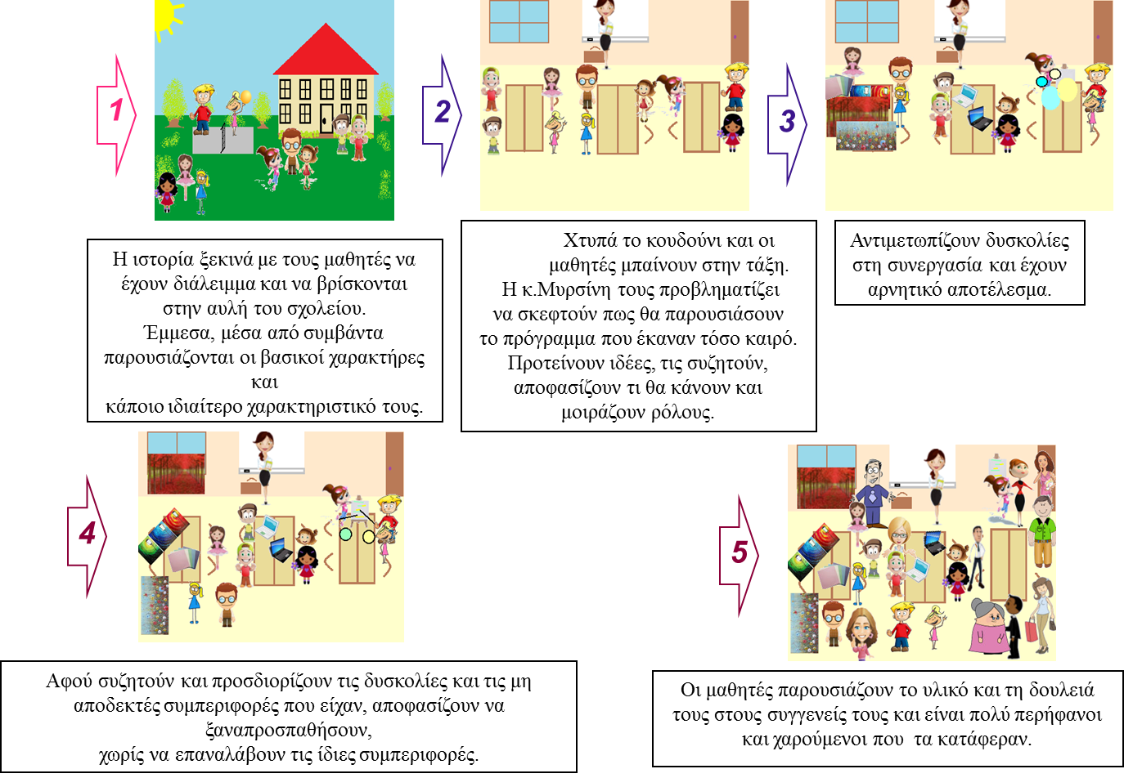
Classroom/School social dynamics

Slide 28

Science

Slide 29


http://www.storylogicnet.eu
https://www.facebook.com/Story-Logic-Net-1989121254498121/
Find us online

